Slide 1
PEP Input Class
Presented By
Kanika Sharma

Slide 2
Topics to be covered…
Classes & objects
Nested classes
Static members
Friend keyword
Array of objects
Passing object as argument
Returning object as argument

Slide 3
Objects
Objects
Object: Complex data type that has an identity, contains other data types called attributes and modules of code called operations or methods
Attributes and associated values are hidden inside the object.
Any object that wants to obtain or change a value associated with other object, must do so by sending a message to one of the objects (invoking a method)

Slide 4
Objects
methods (methods)
Object: woman
Attributes (values)
method:
Set_salary
Age: 35
Salary: 10
Set_salary (20)
Get_age
employer
friend

Slide 5
Classes
Classes are templates that have methods and attribute names and type information, but no actual values!
Objects are generated by these classes and they actually contain values.
We design an application at the class level.
When the system is running objects are created by classes as they are needed to contain state information.
When objects are no longer needed by the application, they are eliminated.

Slide 6
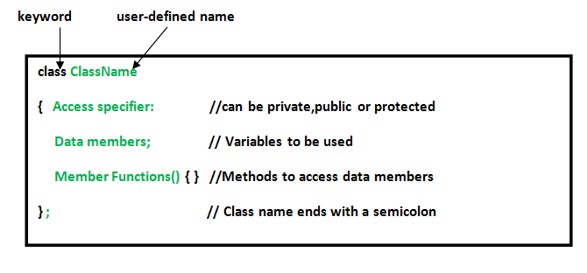
Declaration of class

Slide 7
Public, Private & Protected
Attributes can be public or private:
Private: it can only be accessed by its own methods
Public: it can be modified by methods associated with any class (violates encapsulation)
Methods can be public, private or protected:
Public: it’s name is exposed to other objects.
Private: it can’t be accessed by other objects, only internally
Protected: (special case) only subclasses that descend directly from a class that contains it, know and can use this method.

Slide 8
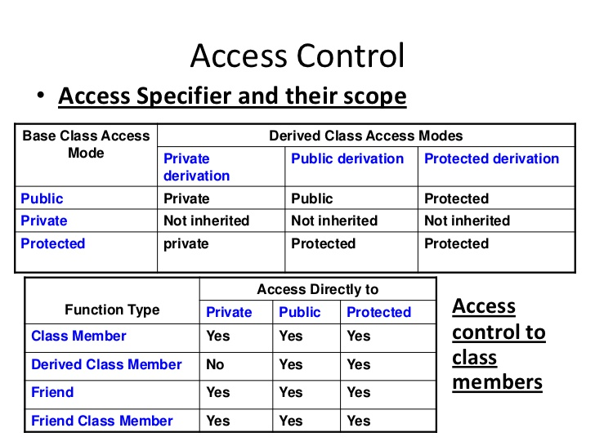

Slide 9
Class & Objects
CLASS: Furniture
Name
methods: Example
ChangeNumber
Number
Objects:
Desk
ChairA
ChairB
123445
32143
45687

Slide 10
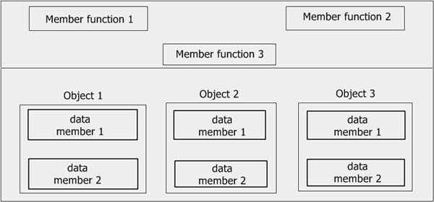
Memory allocation in classes

Slide 11
Nested classes
A nested class is a class which is declared in another enclosing class.
The members of an enclosing class have no special access to members of a n ested class; the usual access rules shall be obeyed

Slide 12
Static data members
Static data members are class members that are declared using static keywords. A static member has certain special characteristics. These are:
Only one copy of that member is created for the entire class and is shared by all the objects of that class, no matter how many objects are created.
It is initialized before any object of this class is being created, even before main starts.
It is visible only within the class, but its lifetime is the entire program

Slide 13
Static member function
A static member function can be called even if no objects of the class exist and the static functions are accessed using the class name and the scope resolution operator ::.
A static member function can only access static data member, other static member functions and any other functions from outside the class.
Static member functions have a class scope and they do not have access to the this pointer of the class. You could use a static member function to determine whether some objects of the class have been created or not.

Slide 14
Program on static member
#include <iostream>
using namespace std;
class student
{
static int stnum;
public:
static void count()
{
stnum++;
}
void display()
{
cout<<"number of student is:\t"<<stnum<<endl;
}
};
int student :: stnum=1;
int main()
{
student s;
for(int i=1;i<5;i++)
{
student::count();
s.display();
}
return 0;
}

Slide 15
Debug the code
#include<iostream>
class Test {
static Test * fun() {
return this;
}
};
int main()
{
return 0;
}

Slide 16
Solution
Correct code
#include<iostream>
class Test {
Test * fun() {
return this;
}
};
int main()
{
getchar();
return 0;
}
#include<iostream>
class Test {
static Test * fun() {
return this; // compiler error
}
};
int main()
{
getchar();
return 0;
}
static member functions do not have this pointer.

Slide 17
Debug the code
#include<iostream>
class Test {
static void fun() const {
return;
}
};
int main()
{
return 0;
}

Slide 18
Solution
#include<iostream>
class Test {
static void fun() const { // compiler error
return;
}
};
int main()
{
return 0;
}
A static member function can not be declared const, volatile, or const volatile.

Slide 19
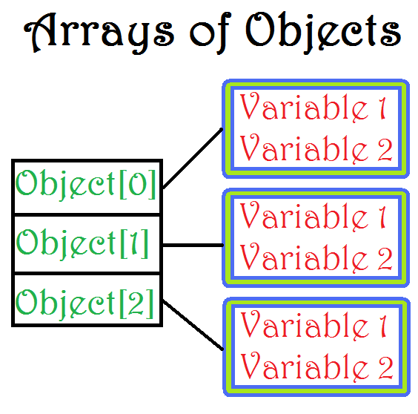
Array of objects

Slide 20
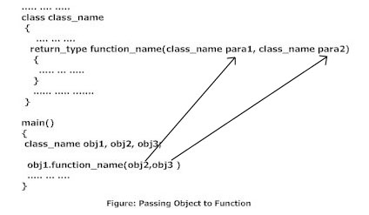
Object as function argument
Passing by value
Passing by reference

Slide 21
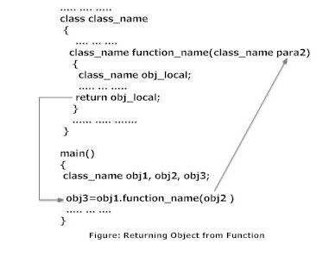
Returning object

Slide 22
Friend function
A C++ friend functions are special functions which can access the private members of a class.
The declaration of friend function should be made inside the body of class starting with keyword friend.
Friend function is used when we need to operate on data of two or more objects of same or different classes.
Friend of the class can be member of some other class.
Friend functions are not member functions

Slide 23
Properties of Friend functions
It can't be called using object like other member function.
It is called like normal functions.
Private member can be accessed inside friend function using object name and dot(.) operator.
It can take multiple objects as parameter as required.
It should be declared in all the classes whose objects are sent as parameter.
It can be declared or defined in private, public or protected section of a class.

Slide 24
Friend Classes
A friend class can access private and protected members of other class in which it is declared as friend.
It is sometimes useful to allow a particular class to access private members of other class.
Friendship is not mutual. If a class A is friend of B, then B doesn’t become friend of A automatically.
Friendship is not inherited.

Slide 25
Program on Friend Classes
class B {
public:
void show_value(A x) {
cout <<endl << "Accessing the value of friend" <<x.a;
}
};
int main()
{
A a;
B b;
a.getvalue();
b.show_value(a);
return 0;
}
#include <iostream>
using namespace std;
class A {
int a;
public:
void getvalue()
{
cout<<"Enter a value";
cin>>a;
}
friend class B; // Friend Class
};

Slide 27
Predict the output
#include <iostream>
using namespace std;
class Test
{
static int x;
public:
Test() { x++; }
static int getX() {return x;}
};
int Test::x = 0;
int main()
{
cout << Test::getX() << " ";
Test t[5];
cout << Test::getX();
}

Slide 28
Answer 0 5

Slide 29
Mock Intreview
Can a C++ class have an object of self type?
Why is the Size of an Empty Class Not Zero in C++?

Slide 30
Answer 1
class Test {
static Test self; // works fine
};
class Test {
Test * self; // works fine
};
class Test {
Test self; // Error
};

Slide 31
Thanks.

